Slide 1
Definitions of Fairness
Keith Burghardt and Kristina Lerman
(slides modified from Fred Morstatter)
keithab@isi.edu

Slide 2
What is fairness?
Not one established definition, many from many different levels.
Borrows from:
Social sciences
Philosophy
In computer science, three macro definitions:
Group fairness
Treat different groups equally.
Individual fairness
Give similar predictions to similar individuals.
Subgroup fairness
Apply group fairness to a large collection of subgroups.

Slide 3
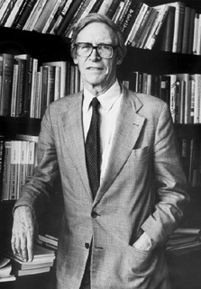
John Rawls (1921 – 2002)
Developed theory of “Justice as Fairness”
First principle: equal liberties (political system)
Everyone has some set of liberties (“indefeasible” i.e., never overturned)
Second principle: (law)
Equality of opportunity (first priority)
Everyone has a chance at an opportunity
Promoting interests of least advantaged (second priority)
If everyone has an opportunity, greatest benefit for least-advantaged
Notes:
”Original Position” – which world would you want to live in if you didn’t know your social position?

Slide 4
Notation
A – set of protected attributes
X – all other observable attributes
U – set of latent attributes not observed
Y – outcome to be predicted
Ŷ – predictor, dependent on A, X, U.

Slide 5
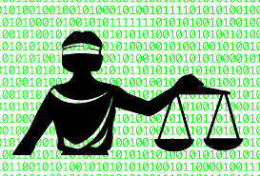
Take 1: Fairness through Unawareness
An algorithm is fair so long as any protected attributes A are not explicitly used in the decision-making process.
Any mapping Ŷ : X → Y that excludes A satisfies this (e.g., do not use race to evaluate loans)
However, it can be biased for many reasons.
X still has biases from variables that correlate with A.
A – set of protected attributes
X – all other observable attributes
U – set of latent attributes not observed
Y – outcome to be predicted
Ŷ – predictor, dependent on A, X, U.

Slide 6
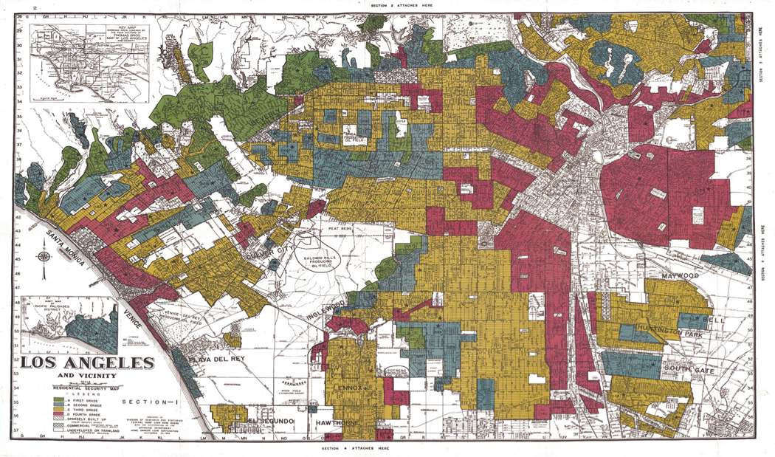
“Redlining” – discrimination by race zipcode

Slide 7
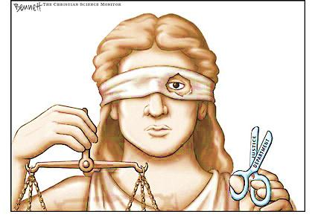
Lesson: Fairness is task-specific
Fairness requires understanding of
classification task and protected groups
“Awareness”

Slide 8
Fairness through Privacy?
“It's Not Privacy, and It's Not Fair”
Cynthia Dwork & Deirdre K. Mulligan. Stanford Law Review.
Privacy is no Panacea: Can’t hope to have
privacy solve our fairness problems.
“At worst, privacy solutions can hinder efforts to identify classifications that unintentionally produce objectionable outcomes—for example, differential treatment that tracks race or gender—by limiting the availability of data about such attributes.“

Slide 9
Group Fairness

Slide 10
Statistical Parity (Group Fairness)
Equalize two groups S, T at the level of outcomes
E.g. S = minority, T = S^{c}
Pr[credit = 1 | S] = Pr [credit = 1 | T]
“Fraction of people in S getting
credit same as in T.”

Slide 11
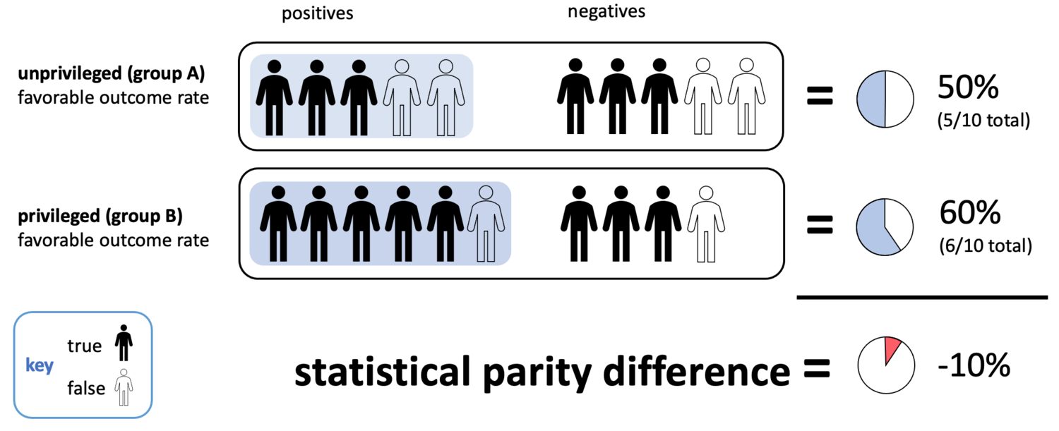
Group Level Graphic Credit: https://www.xyonix.com/blog/how-to-detect-and-mitigate-harmful-societal-bias-in-your-organizations-ai

Slide 12
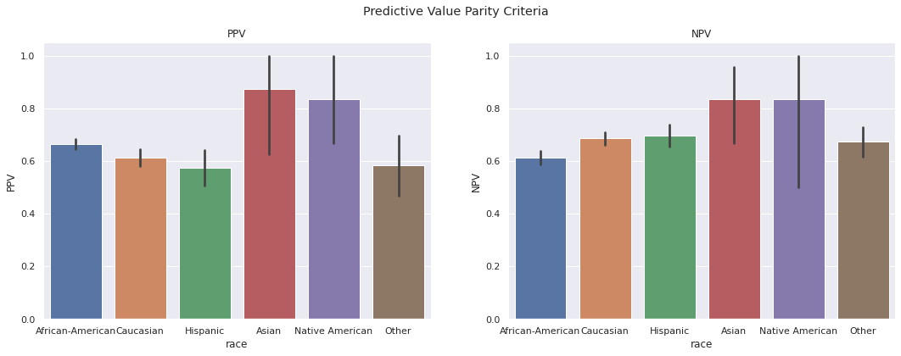
Example from COMPAS
https://afraenkel.github.io/fairness-book/content/08-compas-2.html
Pretty fair (by this definition)

Slide 14
Group fairness definitions are not strong enough as a notion of fairness
Sometimes desirable, but can be abused
Breaking Statistical Parity. Two ways:
Select smartest students in T, random students in S
Students in T will perform better
Does not allow perfect predictor (if Y correlated with A)

Slide 15
Conditional Statistical Parity
Ideal statistical parity
P(d = 1 | L = l, A = m) = P(d = 1 | L= l, A = f)
Difference: Considering these factors, protected and unprotected instances should have the same probability of success.
L must be legitimate.
Imagine the credit example, legitimate:
Credit history, employment, amount requested.
Protected class 1
Pr[credit = 1]
Protected class 2
Score
Notes:
Example, female and male pay gap.
For example, among defendants who have the same number of prior convictions, black and white defendants are detained at equal rates.

Slide 16
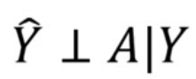
Equalized Odds
Definition:
Prediction does not provide information about A beyond what Y already does.
P(Ŷ| Y = y, A = m) = P(Ŷ | Y = y, A = f)
Protects against accuracy disparity.
A – set of protected attributes
X – all other observable attributes
U – set of latent attributes not observed
Y – outcome to be predicted
Ŷ – predictor, dependent on A, X, U.
Notes:
Unlike demographic parity, equalized odds allows ̂Y to depend on A but only through the target variable Y.
A perfect predictor satisfies equalized odds.

Slide 17
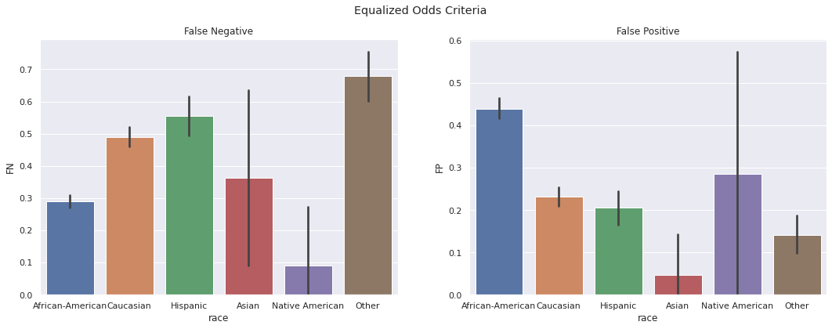
Example from COMPAS
https://afraenkel.github.io/fairness-book/content/08-compas-2.html

Slide 18
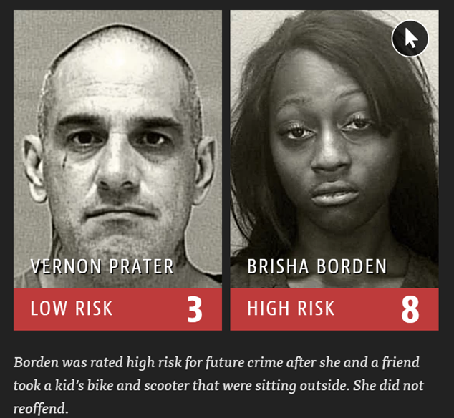
Example from COMPAS
COMPAS fails to achieve fairness
(by this definition)

Slide 19
Equality of Opportunity
In a binary case, we think of Y=1 as the “advantaged” outcome.
Require non-discrimination only within this outcome.
E.g., people who pay back their loan ought to have an equal opportunity of getting the loan in the first place.
P(Ŷ = 1 | A = m, Y = 1) = P(Ŷ = 1 | A = f, Y = 1).
Relaxation of Equalized Odds
(Important in for treatments)
A – set of protected attributes
X – all other observable attributes
U – set of latent attributes not observed
Y – outcome to be predicted
Ŷ – predictor, dependent on A, X, U.
He, Burghardt, Lerman. AIES 2022

Slide 20
Achieving Eq. Odds and Eq. of Opportunity
Goal: find an Eq. odds or Eq. Opportunity predictor Ỹ
Derived from a (possibly discriminatory) predictor, Ŷ
The joint distribution is required at training time.
At prediction time, we only have R, A.
A – set of protected attributes
X – all other observable attributes
U – set of latent attributes not observed
Y – outcome to be predicted
Ŷ – predictor, dependent on A, X, U.
Notes:
Ỹ should only depend on R and the protected attribute, but it may introduce additional randomness.

Slide 21
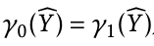
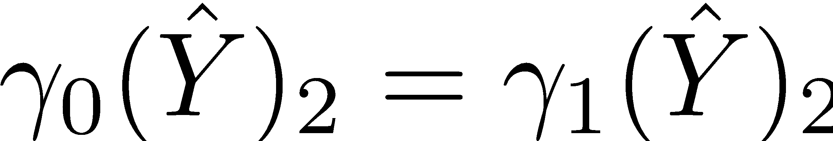
Binary Case
We are adjusting a binary Ŷ, and have a binary A.
Introduce:
Ŷ satisfies:
Equalized odds if
Equal opportunity if
False Positive Rate
True Positive Rate
A – set of protected attributes
X – all other observable attributes
U – set of latent attributes not observed
Y – outcome to be predicted
Ŷ – predictor, dependent on A, X, U.

Slide 22
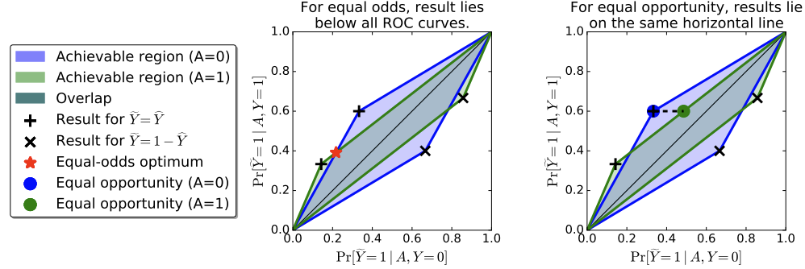
Finding the Optimal Predictor

Slide 23
Individual Fairness
With many slides from Moritz Hardt - Fall 2017

Slide 24

Credit Application
User visits capitalone.com
Capital One uses tracking information provided by the tracking network to personalize offers
Concern: Steering minorities into higher rates (illegal)
Notes:
Capital one could be racist without knowing it.

Slide 25

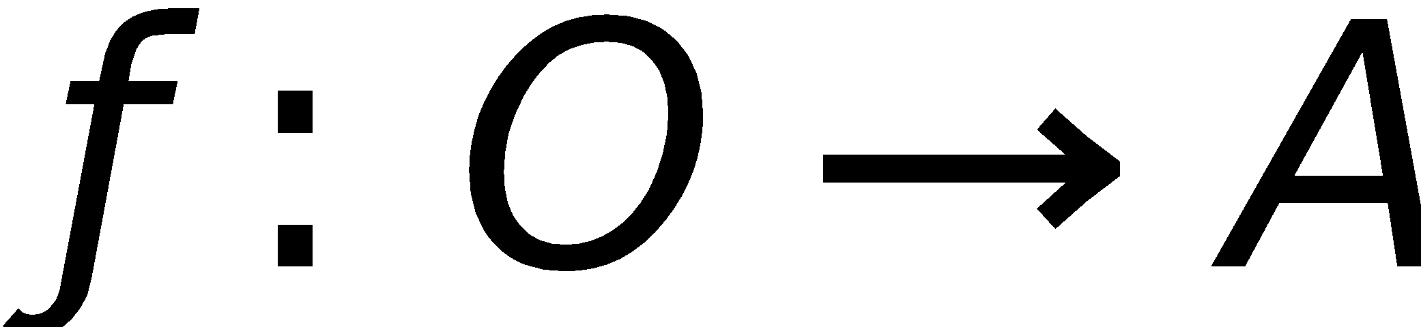

Classifier
(eg. ad network)
Vendor
(eg. capital one)
x
M(x)
V: Individuals
O: outcomes
A: actions

Slide 26

Goal:
Achieve Fairness in the classification step
Assume
unknown,
untrusted,
un-auditable
vendor
x
M(x)
V: Individuals
O: outcomes

Slide 27
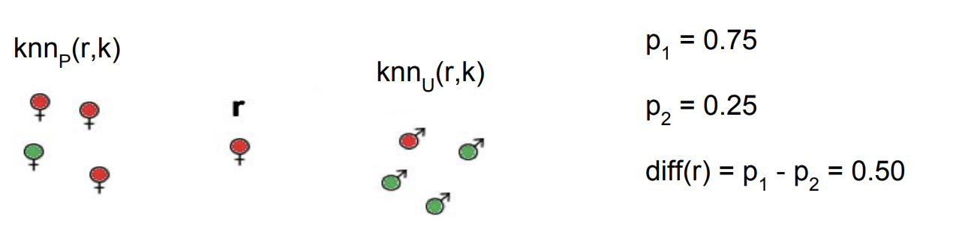
k-NN as Situation Testing (Algorithm)
For r ∈ P(R), look at it’s k-closest neighbors.
In the protected set define p₁ = proportion with the same decision as r
In the the unprotected set define p₂ = proportion with the same decision as r
Measure the degree of discrimination of the decision for r diff(r) = p₁ – p₂

Slide 28
Individual Fairness
Treat similar individuals similarly
Similar for the purpose of
the classification task
Similar distribution
over outcomes

Slide 29
Metric
Assume task-specific similarity metric
Extent to which two individuals are similar w.r.t. the classification task at hand
Ideally captures ground truth
Or, society’s best approximation
Open to public discussion, refinement
In the spirit of Rawls
Typically, does not suggest classification!

Slide 30
Examples
Financial/insurance risk metrics
Already widely used (though secret)
AALIM health care metric
health metric for treating similar patients similarly
Roemer’s relative effort metric
Well-known approach in Economics/Political theory
Notes:
Mention only AALIM
Roemer, strict equality of opportunity obtains when people, irrespectively of circumstances beyond their control, have the same ability to achieve advantage through their free choices. To implement this idea, Roemer sorts people with similar circumstances into types and takes their free choices to be represented by their behavior relative to other members of the same type or, as Roemer calls it, by their ‘relative effort’

Slide 31
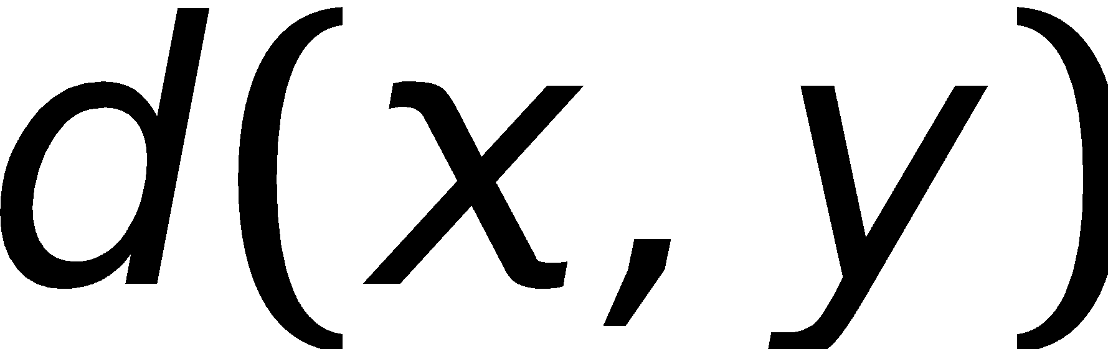
How to formalize this?
Think of V as space
with metric d(x,y)
similar = small d(x,y)
How can we
compare
M(x) with M(y)?
y
M(y)
x
M(x)
V: Individuals
O: outcomes

Slide 32
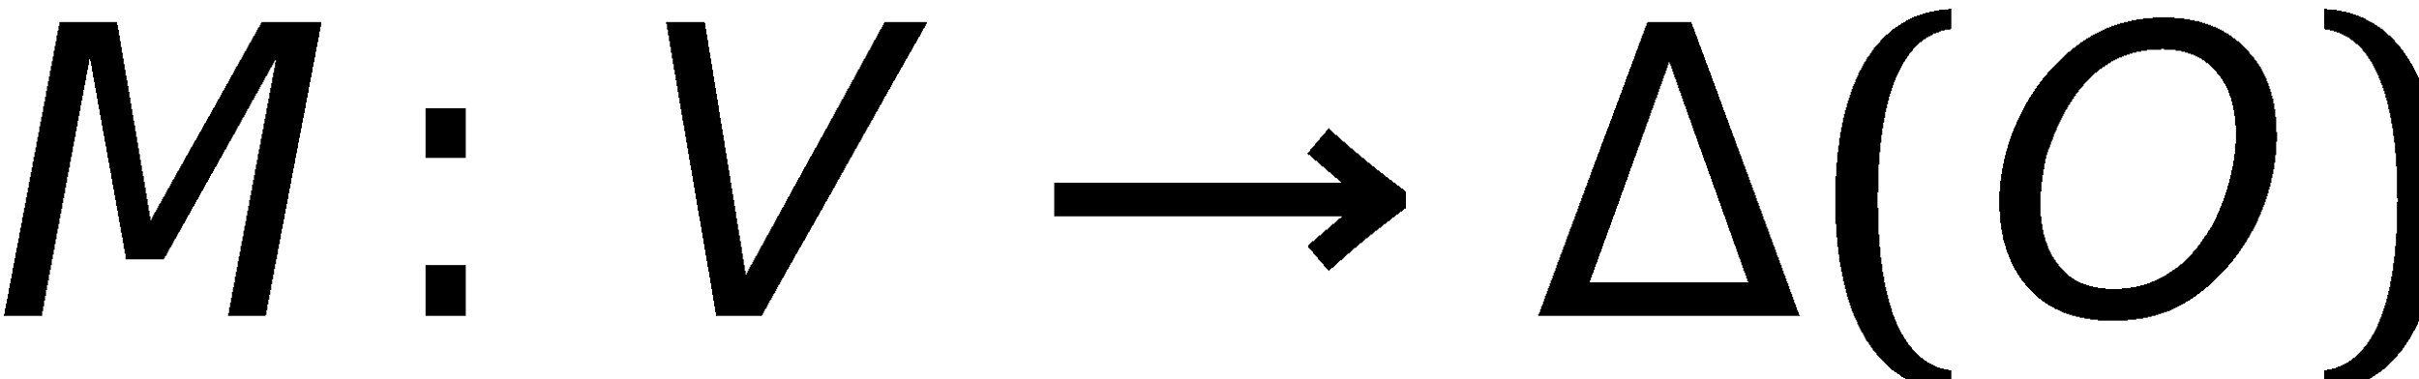
Distributional outcomes
How can we
compare
M(x) with M(y)?
Statistical
distance!
M(y)
y
x
M(x)
V: Individuals
O: outcomes

Slide 33

When does Individual Fairness imply Group Fairness?
Suppose we enforce a metric d.
Question: Which groups of individuals receive (approximately) equal outcomes?
Theorem:
Answer is given by Earthmover distance
(w.r.t. d) between the two groups.

Slide 34
Individual Fairness Caveats
Mapper is only fair before predictions are made.
Mapper says something about distribution.
It is possible to receive an unfair draw from that distribution.
Fairness makes no promise of group parity.
If individuals of one group are, on average, very far from the other, a ”fair” algorithm could still discriminate.
T
S
(V,d)

Slide 35
Connection to differential privacy
Close connection between individual fairness and differential privacy [Dwork-McSherry-Nissim-Smith’06]
DP: Fairness condition on set of databases
IF: Fairness condition on set of individuals
 | Differential Privacy | Individual Fairness
Objects | Databases | Individuals
Outcomes | Output of statistical analysis | Classification outcome
Similarity | General purpose metric | Task-specific metric

Slide 36
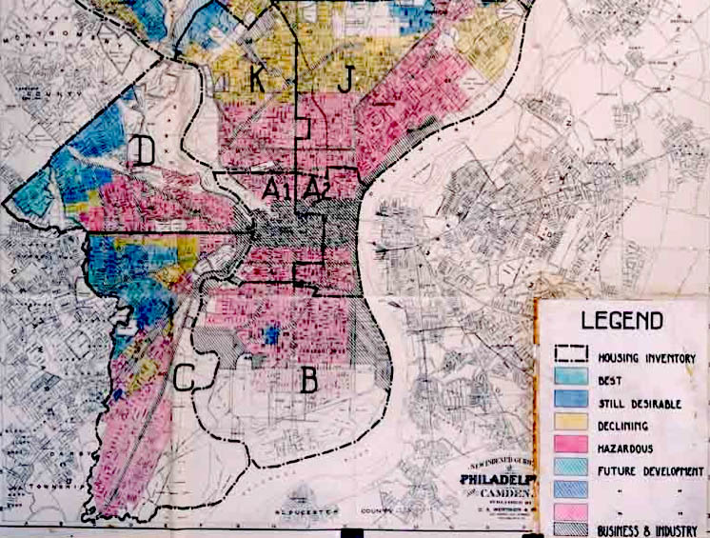
Discrimination Harms
Information use
Explicit discrimination
Explicit use of race/gender for employment
Redundant encoding/proxy attributes
Practices
Redlining
Self-fulfilling prophecy
Reverse tokenism
Notes:
Other attributes that predict the protected one
SFP – building a bad track record
Reverse tokenism - Denying a loan to someone in the advantaged tclass to appear less racist.

Slide 37
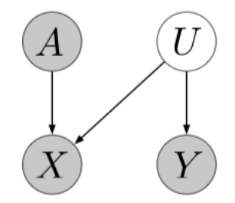
Counterfactual Fairness: Scenario 1
Toy example
A = race
X = “owns a red car”
Y = “crashes car within a year”
What is U?
Aggressiveness / Carelessness
Hidden attribute that determines the outcome.
Notes:
A does not cause Y.
X informs A and U.
A – set of protected attributes
X – all other observable attributes
U – set of latent attributes not observed
Y – outcome to be predicted
Ŷ – predictor, dependent on A, X, U.

Slide 38
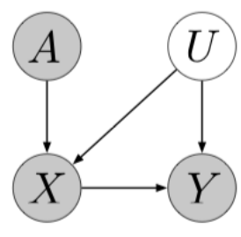
Counterfactual Fairness: Scenario 2
Crime rates by neighborhood.
X = the neighborhood
A = race
Y = 1 if police record
U = socioeconomic factors, policing practices
A – set of protected attributes
X – all other observable attributes
U – set of latent attributes not observed
Y – outcome to be predicted
Ŷ – predictor, dependent on A, X, U.
Notes:
X depends on A due to historically segregated housing
Higher arrest rates are due to greater policing, not due to race
Y = 0 doesn’t mean they have never committed a crime, just that they haven’t been caught.
If individuals in the training data have not already had equal opportunity, algorithms enforcing EO will not remedy it.
Goal of counterfactual fairness is to model U and base predictions on it.

Slide 39
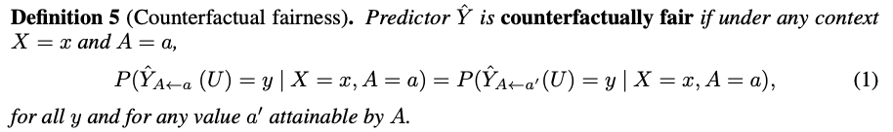

Definition of Counterfactual Fairness
To be fair, A should not be a cause of Ŷ.
Changing A while holding things not dependent on A will not change Ŷ.
Individual or Group?
If Ŷ is a function of , then IF exists when two individuals with the same W are treated the same way.
A – set of protected attributes
X – all other observable attributes
U – set of latent attributes not observed
Y – outcome to be predicted
Ŷ – predictor, dependent on A, X, U.

Slide 40
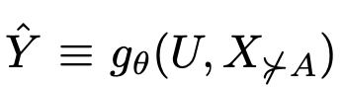
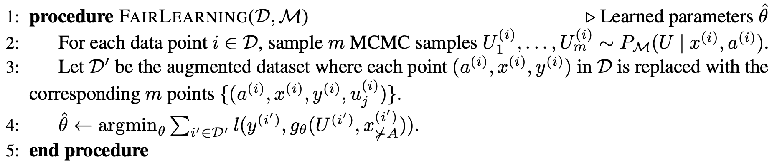
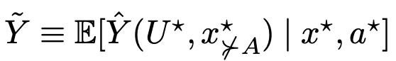
Implementing Counterfactual Fairness
Dataset
Causal Model
A – set of protected attributes
X – all other observable attributes
U – set of latent attributes not observed
Y – outcome to be predicted
Ŷ – predictor, dependent on A, X, U.
Given observables, A U X, extracts latent sources.
Counterfactual assumptions must underlie all approaches that claim to extract the sources of variation of the data as "fair" latent components.
Notes:
P_M is the conditional distribution of the background variables (available by assumption)
Discuss the issues of using an expectation.

Slide 41
Interpretation
Extract causes of Y which are not mediators between A and Y.
Find the “best approximation” to Y within the space of functions that exclude such mediators.
Even if Y is “unfair,” (A is a cause of it), by construction the predictor will be fair.

Slide 42
Workflow
Regardless of what machine learning algorithm you’re using, work with a domain expert to estimate a causal model of your data.
Model of the world, not the software.
Choose any machine learning algorithm of interest that takes your observed and unobserved variables.
Select a set of variables based on which sets respect counterfactual fairness.
If necessary, infer unobserved variables.

Slide 43
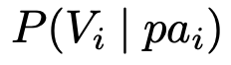
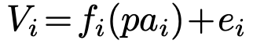
Designing M
FairLearning requires a model M, but how to build?
Three levels:
Build Ŷ using only the observable non-descendants of A. Reality: few variables not descendants of demographic factors.
Create background latent variables that cause observable variables. Reality: requires domain knowledge, learning algorithms.
Create a fully deterministic model with latent variables.
The distribution comes from
Notes:
Additive error model. Error term e_i then becomes part of \hat{Y}

Slide 44
Illustration: Law School Success
Dataset: race, sex, LSAT, pre-law school GPA, first year GPA (FYA)
Question: Which students will have a high FYA?
Goal: Predict FYI without using information about race and sex.
How to use fair prediction?

Slide 45
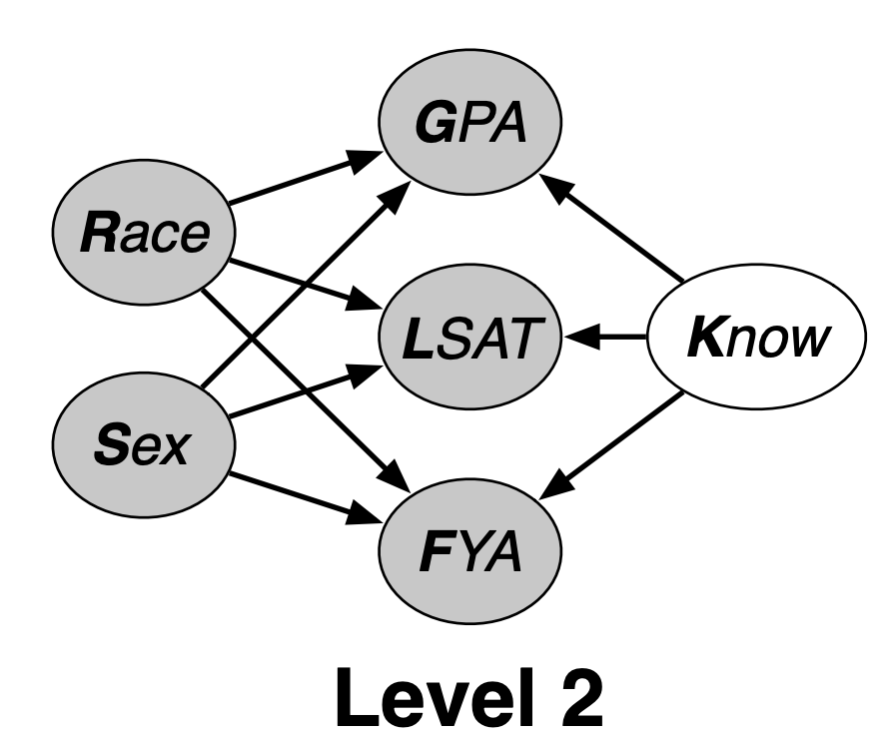
Designing M
Level 1 – impossible (SME believes all attributes are biased by race and sex).
Level 2 – postulate a student’s knowledge (K) affects GPA, LSAT, and FYA.

Slide 46
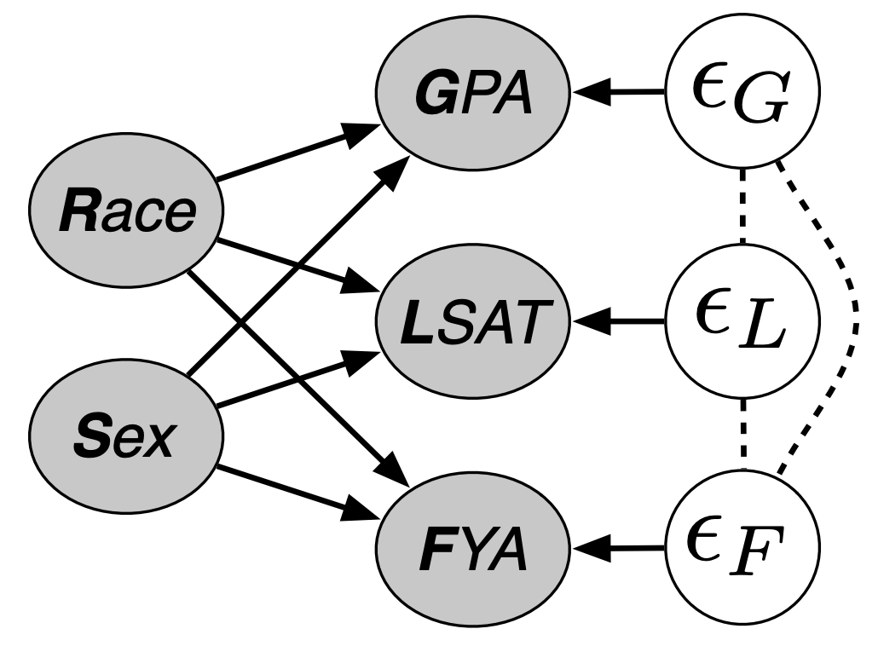
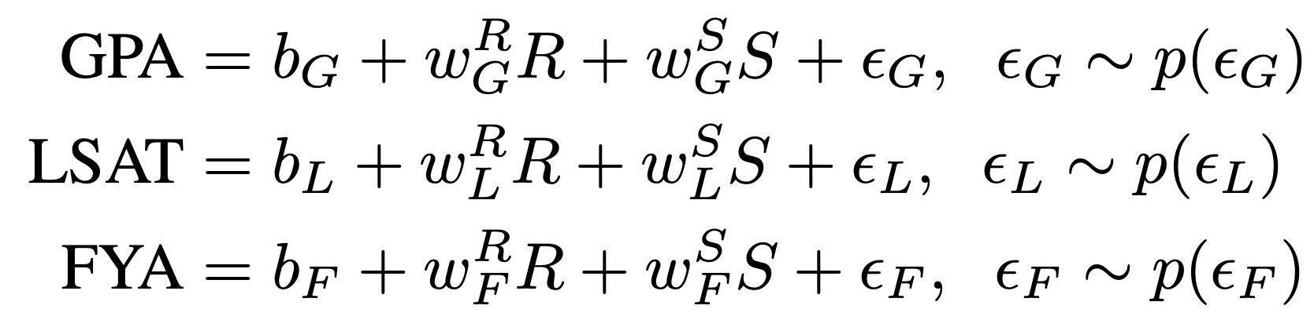
Designing M (cont’d)
Level 3 – fully deterministic model w/ latent variables.
Estimate e_{G}, e_{L} by fitting two models to predict GPA, LSAT.
Compute the residuals.
Use residuals to predict FYA.

Slide 47
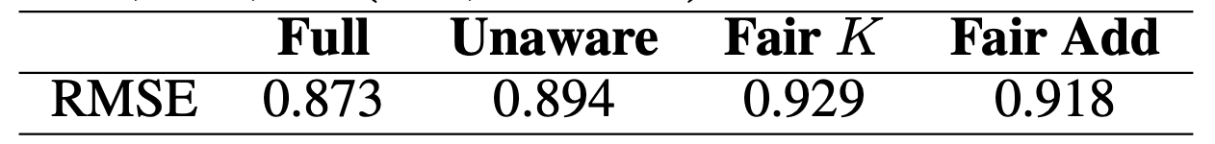
Results
Baselines:
Full: Use all of the features.
Fairness through Unawareness: Delete race and sex, use remainders.

Slide 48
Counterfactual Fairness – Are baselines fair?
Questions: Are the baseline methods counterfactually fair?
Assume the real model of the world is Level 2.
Generate samples from this using:
observed race and sex, or
counterfactual race and sex.
Built models on both, look at distribution of predicted FYAs.

Slide 49
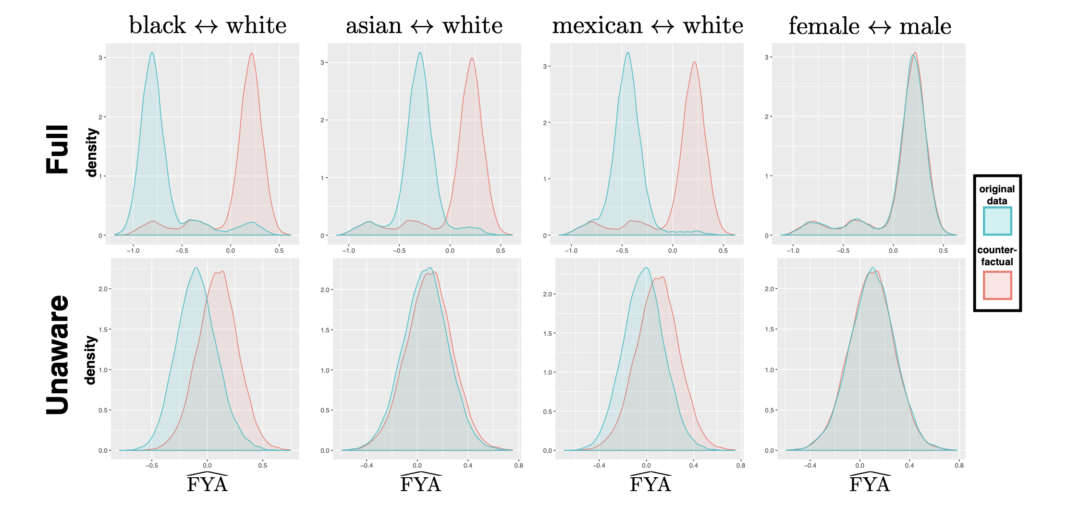
Results
Notes:
Goal is to see how much the predictions move as a function of these (supposedly) irrelevant features.
If it were fair, these distributions would be on top of each other.

Slide 50
Lots of open problems/direction
Metric
Social aspects, who will define them?
How to generate metric (semi-)automatically?
Earthmover characterization when probability metric is not statistical distance (but infinity-div)
Explore connection to Differential Privacy
Connection to Economics literature/problems
Rawls, Roemer, Fleurbaey, Peyton-Young, Calsamiglia
Quantitative trade-offs in concrete settings

Slide 51
Subgroup Fairness

Slide 52


Weaknesses of statistical fairness notions
(Statistically) easy to check and enforce without making any assumptions, but semantics have limited meaning when applied to individuals…
Toy example: Protected subgroups are “Men”, “Women”, “Blue”, “Green”. Labels are independent of protected attributes.
The following allocation achieves statistical parity and equalized odds:
Blue
Green
Male
Female

Slide 53
Statistical Fairness Notions
The problem: Statistical constraints averaged over coarse subgroups can be “gerrymandered” to pack unfairness into structured subgroups.
No reason to expect it won’t happen with standard optimization techniques: we will see it does.
Just add “green men”, “blue women”, etc. as protected subgroups?
What about other groups?

Slide 54
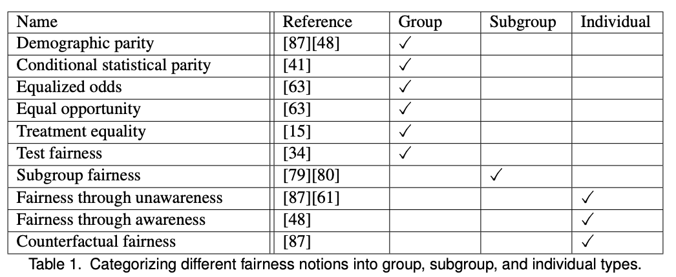
Recap: Fairness Definitions
https://arxiv.org/pdf/1908.09635.pdf
Read Section 4.1
Mehrabi, Ninareh, et al. "A survey on bias and fairness in machine learning." ACM Computing Surveys (CSUR) 54.6 (2021): 1-35.

Slide 55
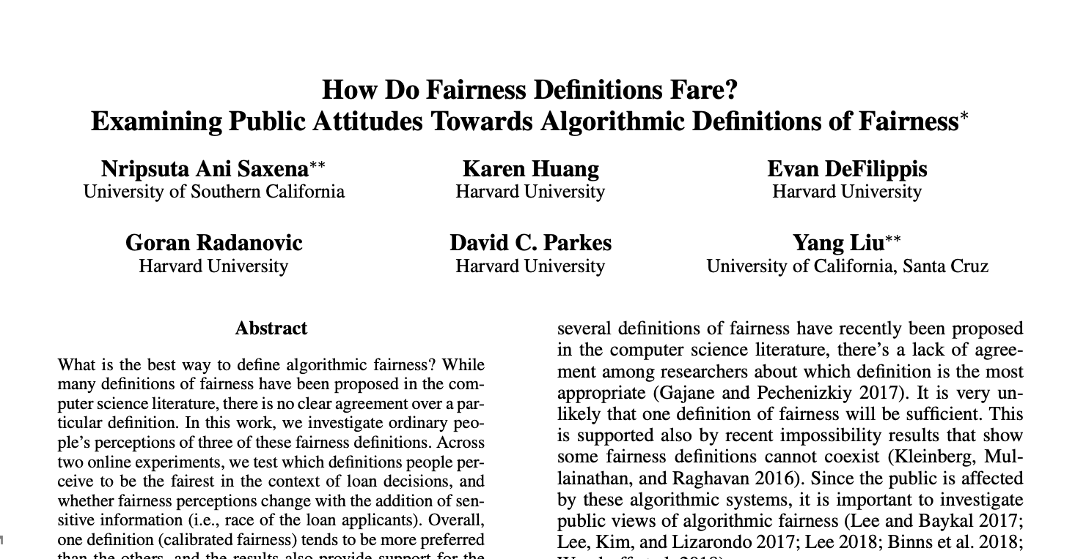

Slide 56
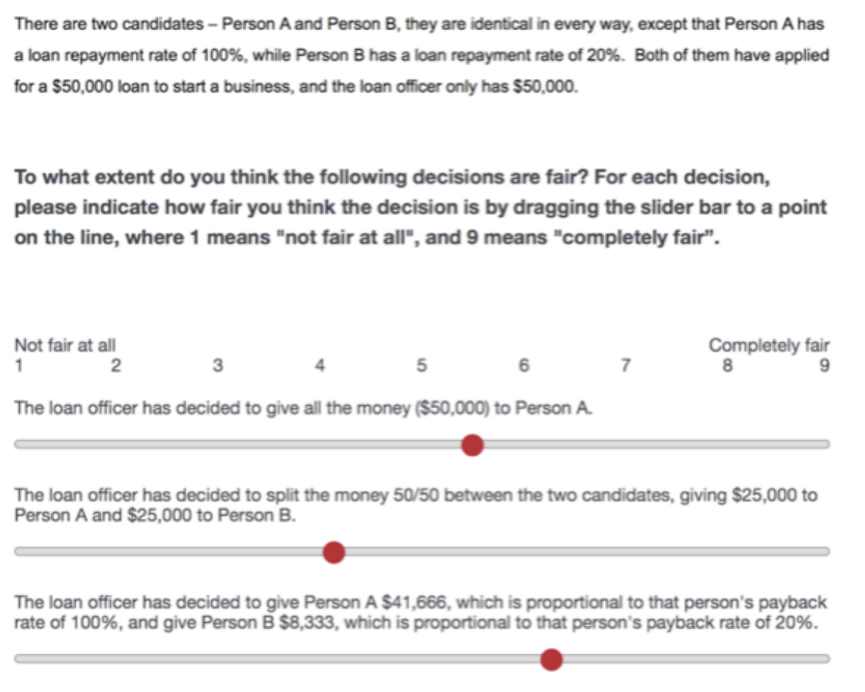
Setup - FTU
Treatments:
55/50
70/40
90/10
100/20
Notes:
IF with discerning
Treat similar people similarly (IF)
Could also be IF, but with a very specific distance function. Also, meritocratic fairness.
Varied the loan repayment rates

Slide 57
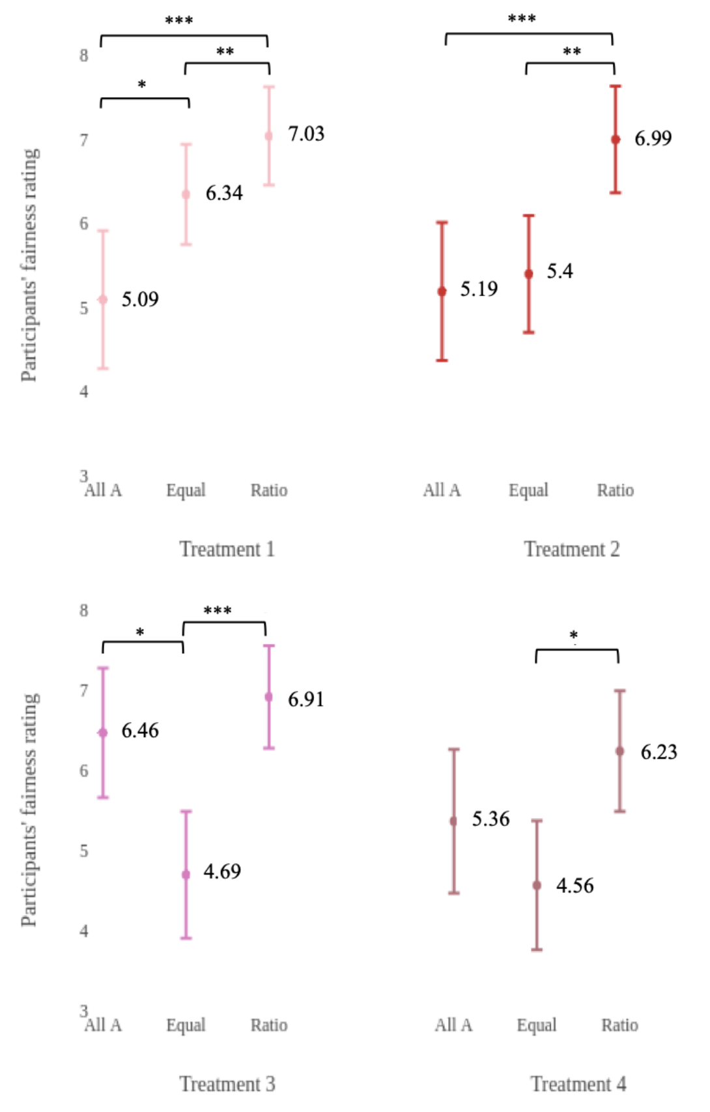

Slide 58
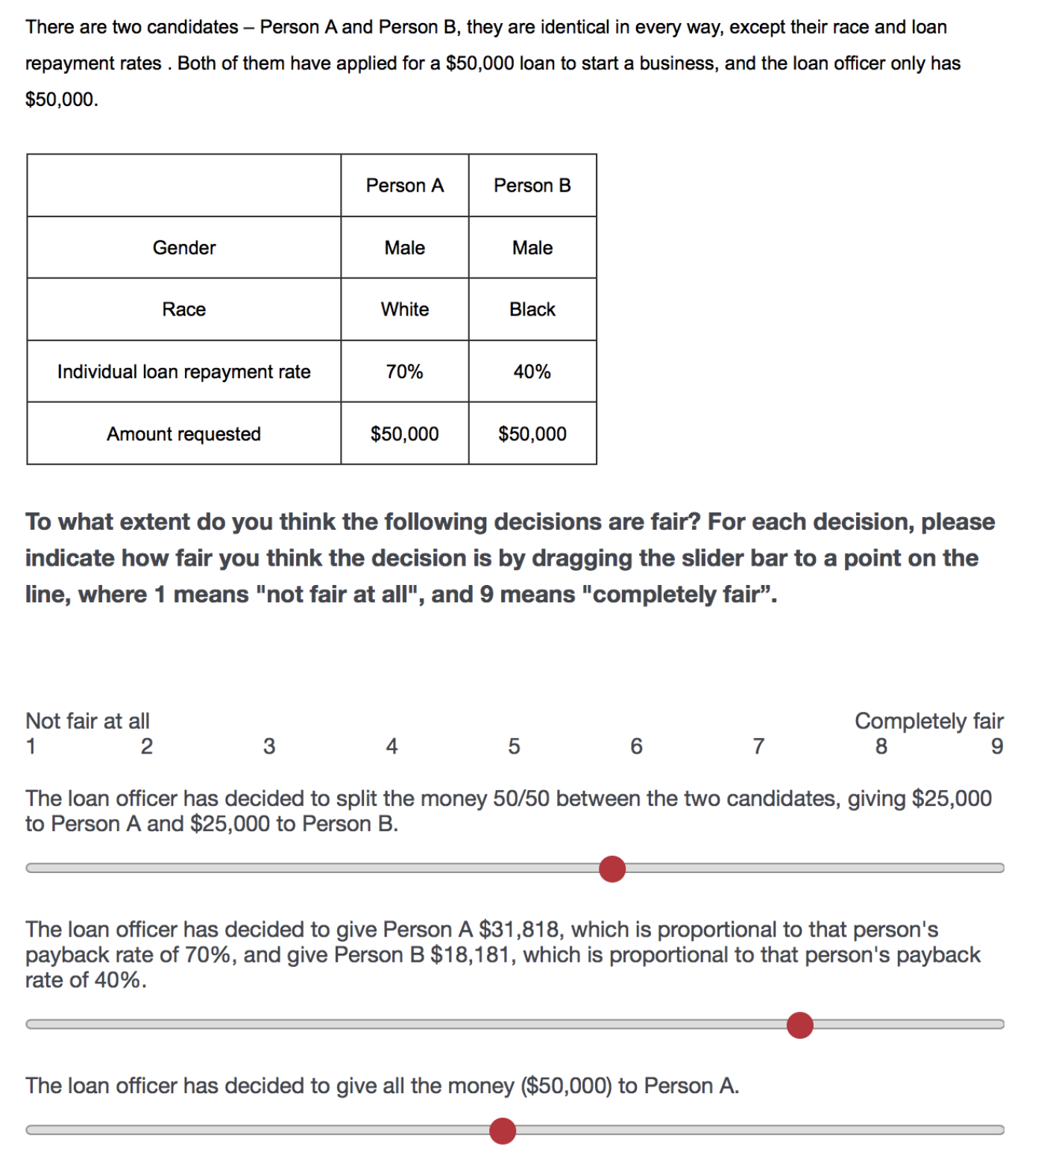
Task 2
Treatments:
55/50
70/40
90/10
100/20
Varied Race

Slide 59
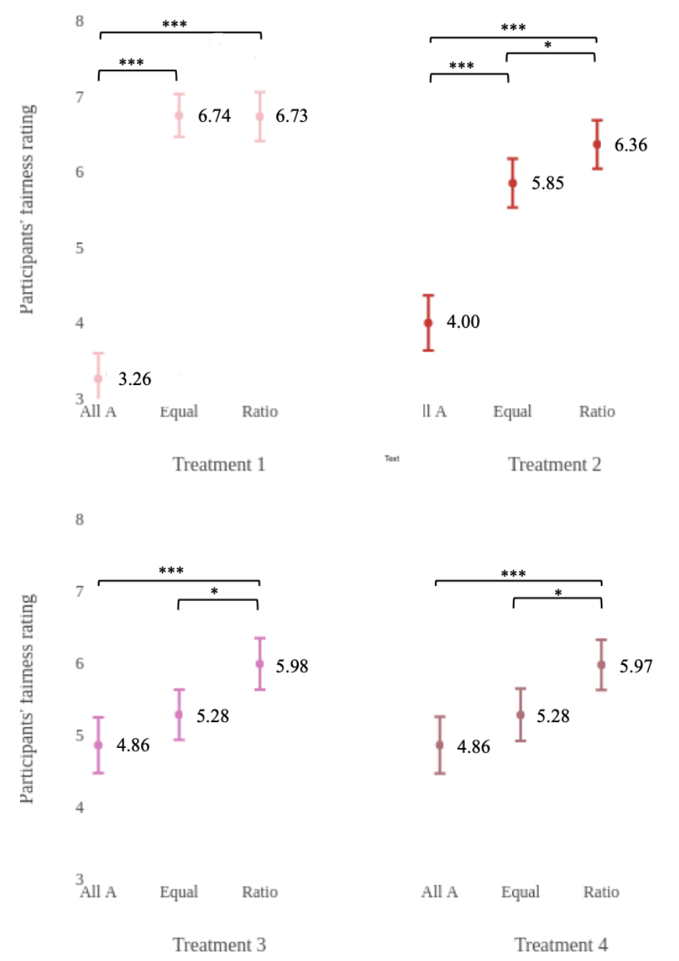
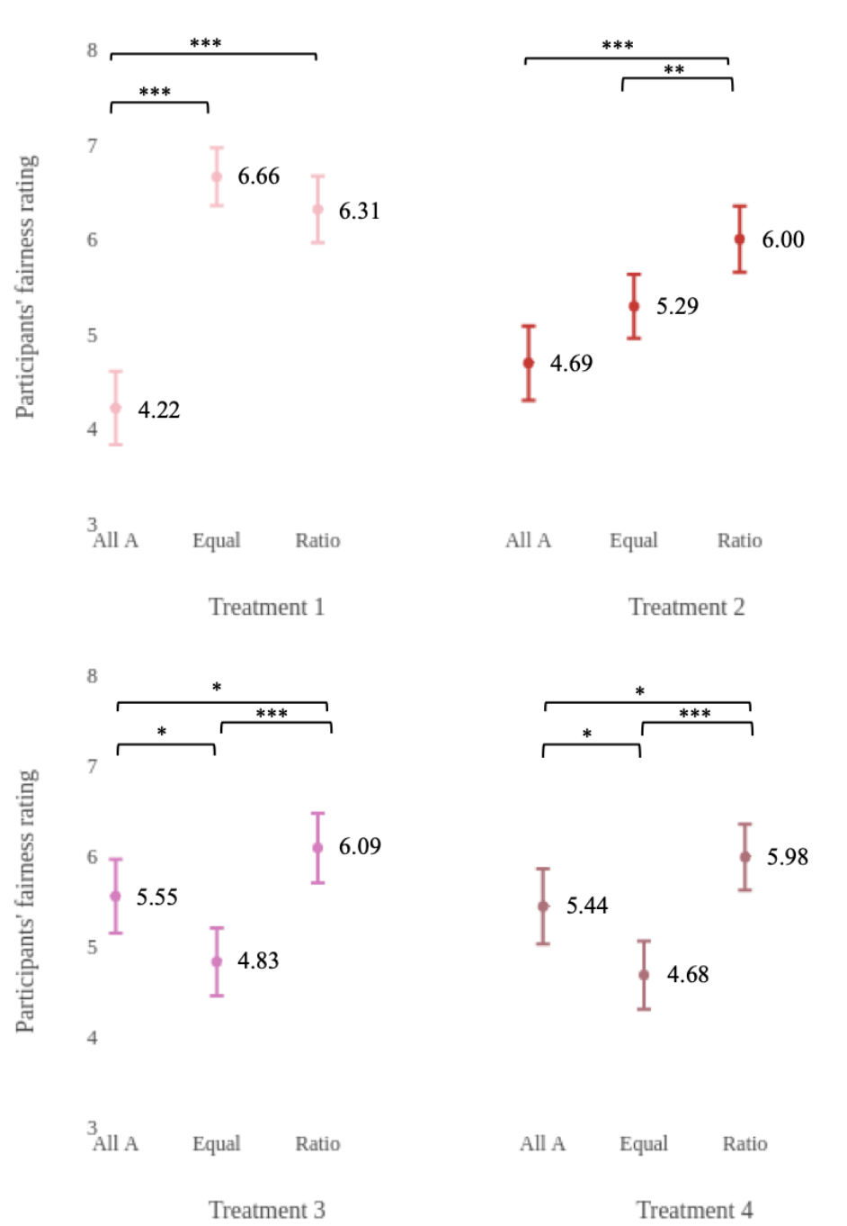
White Candidate Gets More
Black Candidate Gets More

Slide 60
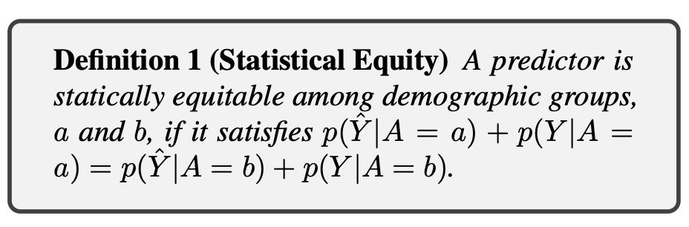
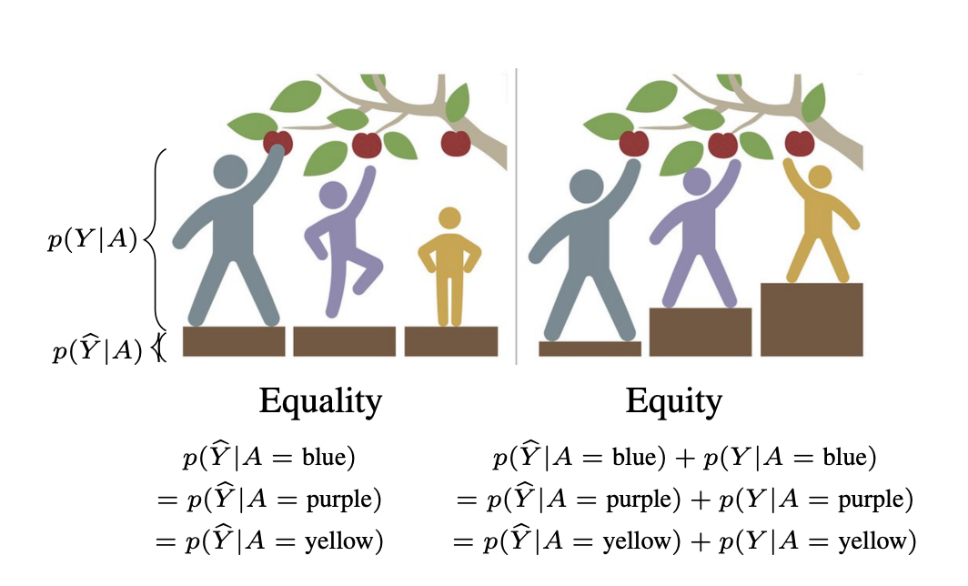
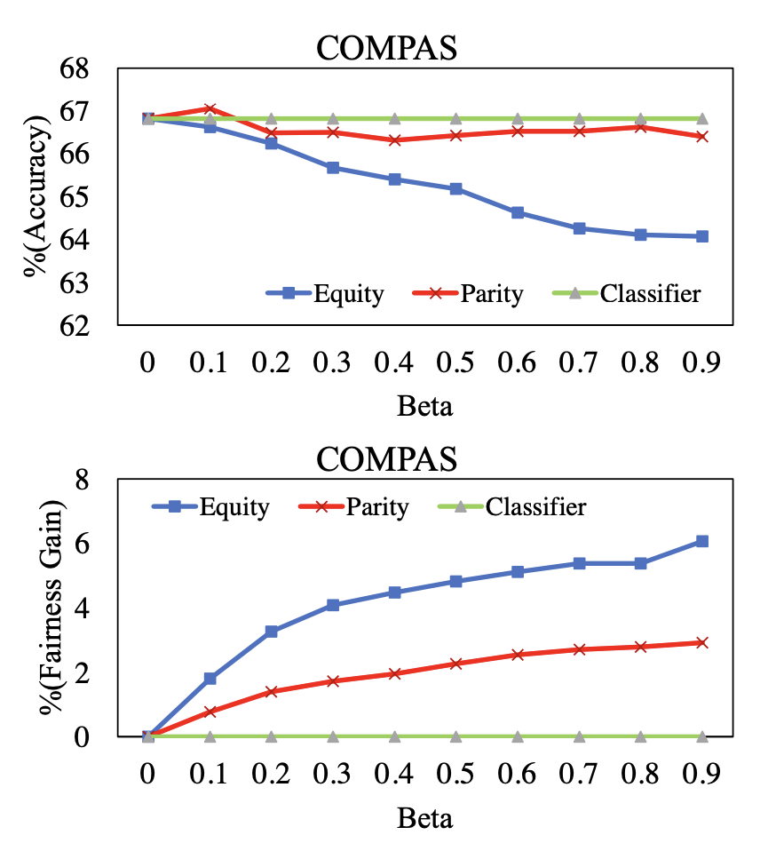
Other Definitions: Equity

Slide 61
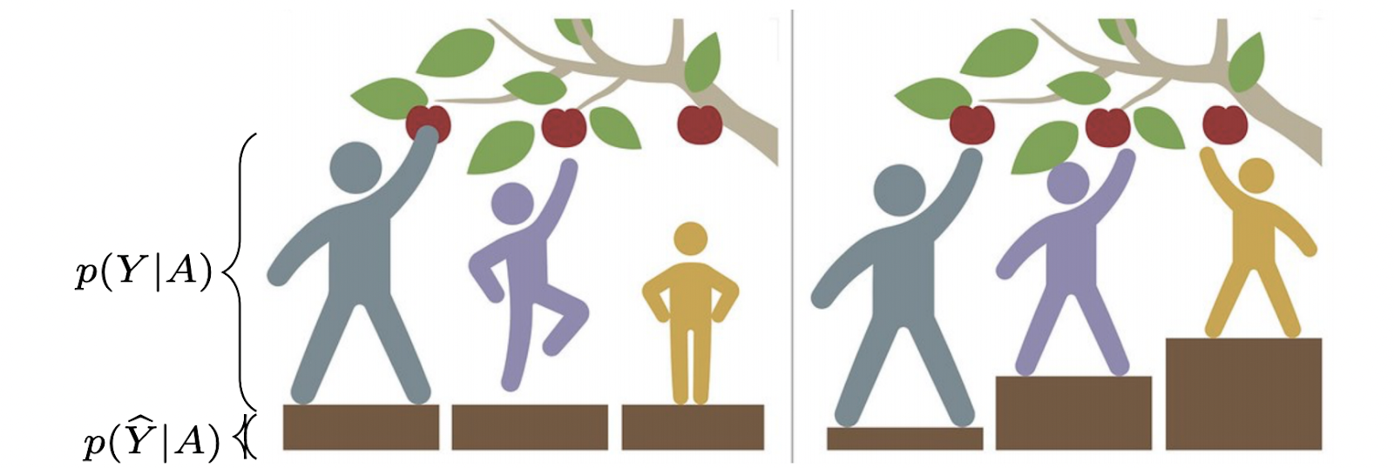
Fairness
Allocation Harms
Representational Harms
“A system withholds certain resources or opportunities from some groups.”*
E.g. Loan allocation systems.
Harm to the identity of certain groups.
Regardless of allocating resources or opportunities.
Mehrabi, N., Huang, Y., & Morstatter, F. (2020). Statistical Equity: A Fairness Classification Objective. arXiv preprint arXiv:2005.07293.

Slide 62
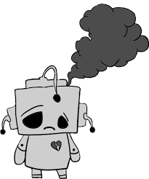


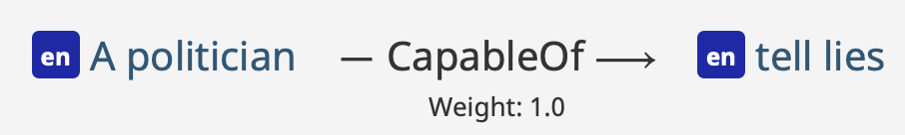
Representational Harms
Investigating representational harms in commonsense knowledge resources and tasks.
What is Commonsense Knowledge?
“Facts about the world that all humans are expected to know.”**
Commonsense knowledge should be facts NOT stereotypes or biases in terms of favoritism or prejudice.
*This presentation contains content that may be offensive or upsetting.
**https://en.wikipedia.org/wiki/Commonsense_knowledge_(artificial_intelligence)
dislike
2

Slide 63
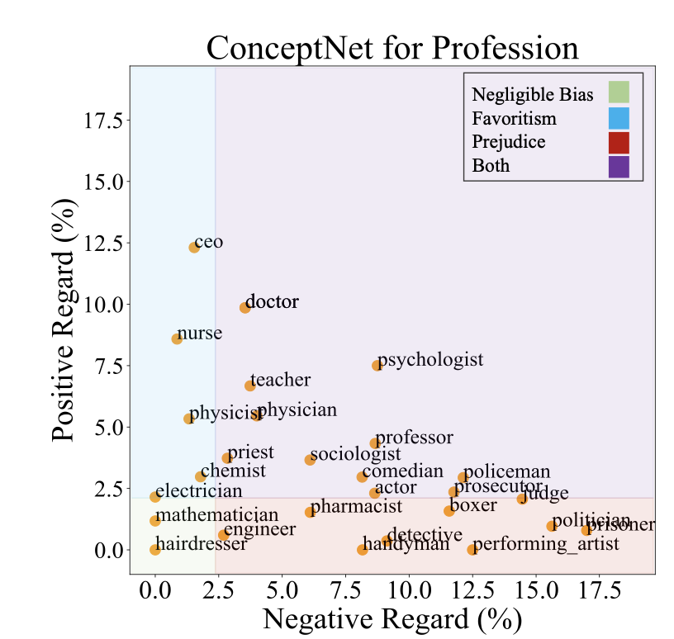
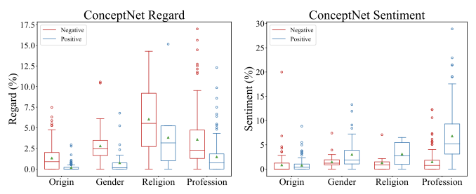
Finding Common Sense Bias
Observed both overgeneralization and disparity in overgeneralization in both Knowledge resources.
The degree of severity was higher in GenericsKB compared to ConceptNet.
Mehrabi, Ninareh, et al. "Lawyers are Dishonest? Quantifying Representational Harms in Commonsense Knowledge Resources." EMNLP 2021.
10

Slide 64
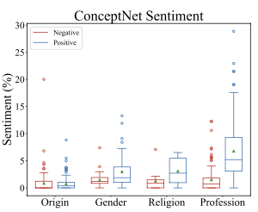
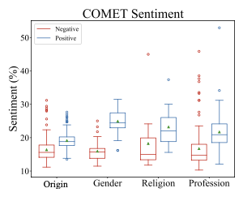
Downstream Task: COMET
COMET is a knowledge completion/generation model.
Trained on GPT and then ConceptNet.
Input the same target words used in ConceptNet, collect triples
Observed both overgeneralization and disparity in overgeneralization in both downstream tasks.
Predictions made by model trained on data
Raw Data
Mehrabi, Ninareh, et al. "Lawyers are Dishonest? Quantifying Representational Harms in Commonsense Knowledge Resources." EMNLP 2021.
13

Slide 65
Conclusion
Looked at different fairness definitions.
Different levels: group, individual, subgroup.
Saw reactions from the public.
Not all fairness definitions can co-exist.

